Slide 1
Data Modelling Session Module-3
Notes:
For information on applying this template to an existing presentations, refer to the notes on slide 2 of this presentation.
The Input area of the Beam can be customised to reflect the content of the presentation. The Input area is an AutoShape with a picture fill. To change this, ensure you have the image you wish to use (ideally a .jpg or a .png file) in an accessible folder. The image should have a ratio of 1:1 to ensure it does not appear distorted. It is not possible to reposition the image within the Input area.
Acceptable images for importing into the Input area of the Beam are the three approved graphics (lines), and black and white photography or illustrations which follow the principles laid out on The Branding Zone. Colour images should never be imported into this area. Please be aware that replacing the Input area with high resolution graphics will significantly increase the file size. Contact your local DDC for assistance with updating the Beam.
Customise the Input area of the Beam as described below.
Click on the View tab from the menu bar and select Master>Slide Master
Right-click on the Input graphic and select Format AutoShape
From the Fill menu, under the Colour and Lines tab, click on the drop-down arrow next to Colour and select the Fill Effects menu
From the Picture tab, click on Select Picture. Navigate to the folder containing the image you wish to insert in the Input area. Highlight the image and tick the Lock picture aspect ratio box. Click on OK
You can now preview the image before continuing. If you are happy with how it looks, click OK to continue. Otherwise, repeat the process until you are happy with your selected image
To exit from Master View, click on View>Normal. The change you made to the Input graphic should now be visible on the title slide.

Slide 2
Introduction
Module-1:
1. Data Modelling Fundamentals - What is it, purpose, etc.
2. The building block of Data Models - Entity, Attributes, Relationship
3. Type of Data Models - Conceptual, Logical, Physical
Module-2:
1. Normalization
2. Relationship & cardinality (1:1, 1:M, M:M)
3. Data Modelling notation
4. Introduction to Dimension Modelling
Module-3:
1. Type of Dimension Models - Star Schema, Snowflake Schema, etc.
2. Different types of Dimensions & Fact table
3. Difference between OLTP & OLAP Modelling.

Slide 3
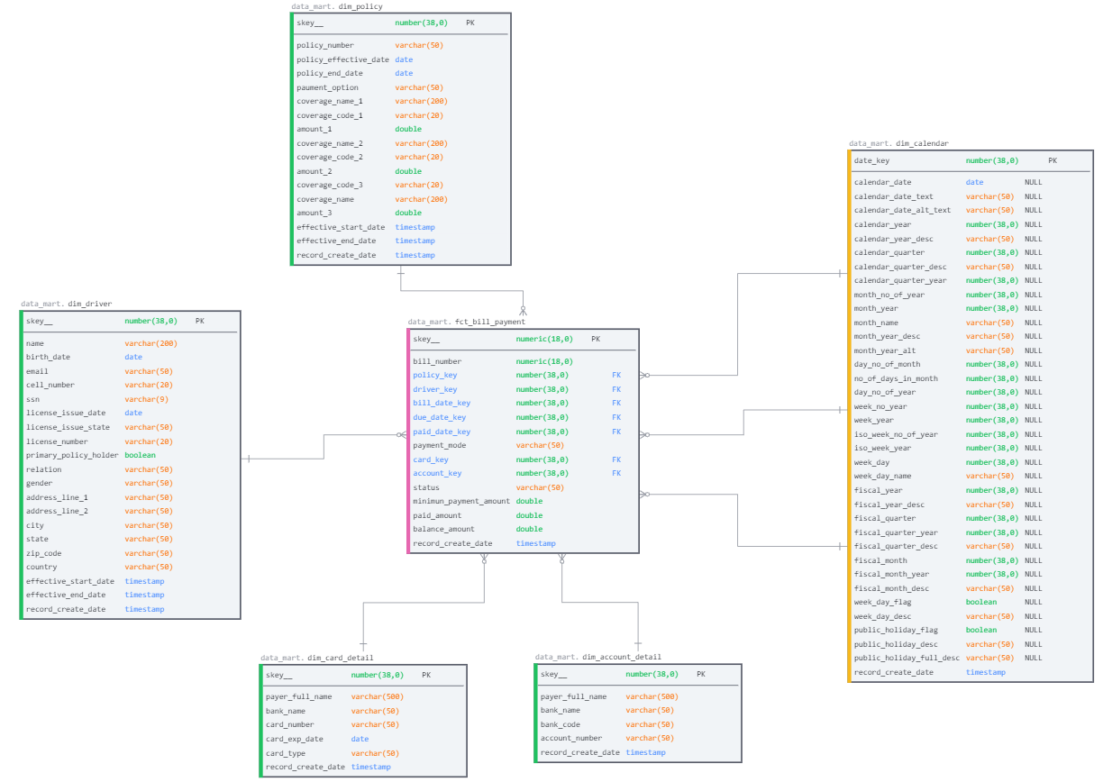
Star Schema

Slide 4
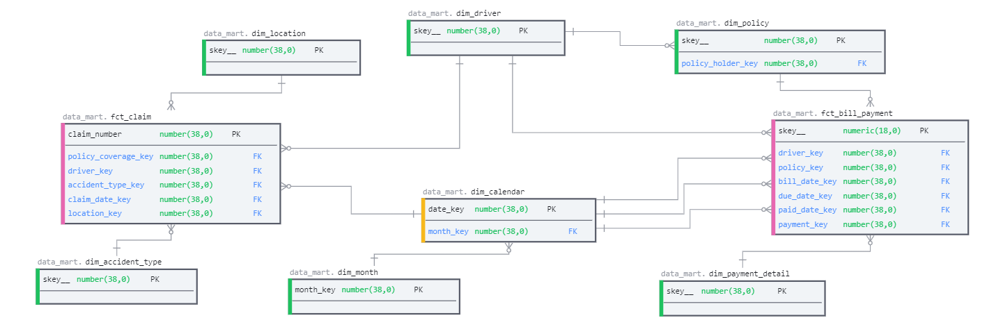
Types Of Dimension
1. Slowly Changing Dimensions
2. Conformed Dimensions
3. Role-Playing Dimensions
4. Static Dimensions
5. Shrunken Dimensions
2
1
4
3
5

Slide 5
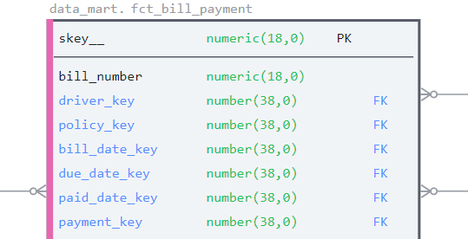
Types Of Dimension
6. Junk Dimensions
7. Stacked dimensions
8. Inferred Dimensions
9. Degenerate Dimensions
10. Rapidly Changing Dimensions
9
Driver
6
Driver Score
10
Mini Driver Dim
7
Accident Type

Slide 6
SCD Types
SCD TYPE-I:
Each change overwrites the existing record.
Cust ID | Customer Name | Contact Number
1 | Mr. Atanu | 8884005511
2 | Mr. Rahul | 700556644
Cust ID | Customer Name | Contact Number
1 | Mr. Atanu Das | 8884005511
2 | Mr. Rahul | 700556644
Cust ID | Customer Name | Contact Number
1 | Mr. Atanu | 8884005511
2 | Mr. Rahul | 700556644
Cust ID | Customer Name | Contact Number
1 | Mr. Atanu Das | 8884005511
2 | Mr. Rahul | 700556644
Cust ID | Customer Name | Contact Number
1 | Mr. Atanu | 8884005511
2 | Mr. Rahul | 700556644
Cust ID | Customer Name | Contact Number
1 | Mr. Atanu Das | 8884005511
2 | Mr. Rahul | 700556644
Cust ID | Customer Name | Contact Number | Start Date | End Date | Is Current
1 | Mr. Atanu | 8884005511 | 01/01/2022 | 31/12/9999 | Y
2 | Mr. Rahul | 700556644 | 01/01/2022 | 31/12/9999 | Y
Cust ID | Customer Name | Contact Number | Start Date | End Date | Is Current
1 | Mr. Atanu | 8884005511 | 01/01/2022 | 01/01/2022 | N
1 | Mr. Atanu Das | 8884005511 | 02/01/2022 | 31/12/9999 | Y
2 | Mr. Rahul | 700556644 | 01/01/2022 | 31/12/9999 | Y
SCD TYPE-II:
Each change creates a new dimension record & close the existing record.

Slide 7
SCD Types (continued)
SCD TYPE-III:
An additional column has to be added to the table to track the original value.
All other change overwrites the current value of the record.
Cust ID | Customer Name | Contact Number
1 | Mr. Atanu | 8884005511
2 | Mr. Rahul | 700556644
Cust ID | Customer Name | Contact Number
1 | Mr. Atanu Das | 8884005511
2 | Mr. Rahul | 700556644
Cust ID | Original Name | Contact Number | Effective Date | Current Name
1 | Mr. Atanu | 8884005511 | 01/01/2022 | Mr. Atanu
2 | Mr. Rahul | 700556644 | 01/01/2022 | Mr. Rahul
Cust ID | Original Name | Contact Number | Effective Date | Current Name
1 | Mr. Atanu | 8884005511 | 02/01/2022 | Mr. Atanu Das
2 | Mr. Rahul | 700556644 | 01/01/2022 | Mr. Rahul

Slide 8
SCD Types (Advance)
SCD TYPE-IV:
New “_history table to introduce. The original table keeps the most recent record, where each change creates a new record in the “_history” table.
Helps for Rapidly changing dimension.
Cust ID | Customer Name | Contact Number
1 | Mr. Atanu | 8884005511
2 | Mr. Rahul | 700556644
Cust ID | Customer Name | Contact Number | Create Date |  | Cust ID | Customer Name | Contact Number | Create Date | End Date
1 | Mr. Atanu | 8884005511 | 01/01/2022
2 | Mr. Rahul | 700556644 | 01/01/2022
Day-2
Cust ID | Customer Name | Contact Number
1 | Mr. Atanu Das | 8884005511
2 | Mr. Rahul | 700556644
Cust ID | Customer Name | Contact Number | Create Date |  | Cust ID | Customer Name | Contact Number | Create Date | End Date
1 | Mr. Atanu Das | 8884005511 | 02/01/2022 |  | 1 | Mr. Atanu | 8884005511 | 01/01/2022 | 02/01/2022
2 | Mr. Rahul | 700556644 | 01/01/2022

Slide 9
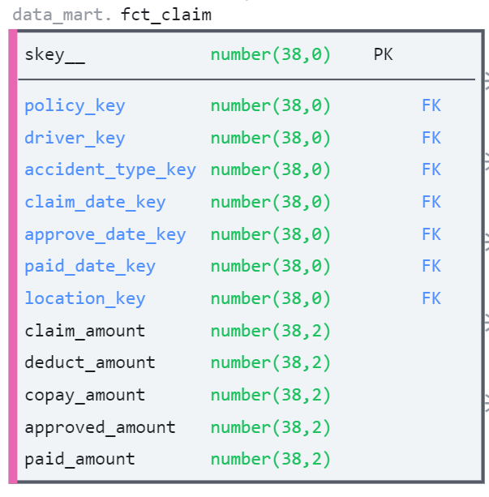
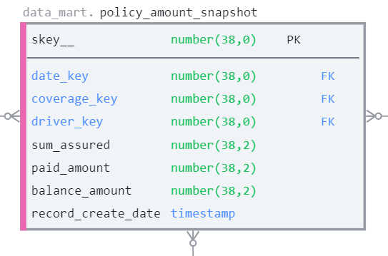
Types Of Fact & Fact Tables
Types of Fact(s):
Additive: Can be added to all dimensions.
Non-additive: Cannot be added to all dimensions.
Semi-additive: Can be added to only some dimensions and not across others.
Types of Fact Table(s):
Transactional: One row per line of a transaction.
Periodic Snapshots: Snapshots in a period of time. The source data of the periodic snapshots fact table is data from a transaction fact table where you choose a period to get the output.
Accumulating Snapshots: Describes the activity of a business process.
2
1
3

Slide 10
Types Of Fact & Fact Tables
Types of Fact(s):
Additive: Can be added to all dimensions.
Example – claim_amount
Non-additive: Cannot be added to all dimensions.
Example: copay_amount
Semi-additive: Can be added to only some dimensions and not across others.
Example: balance_amount

Slide 11
Types Of Fact Tables
Transactional: One row per line of a transaction.
Periodic Snapshots: Snapshots in a period of time. The source data of the periodic snapshots fact table is data from a transaction fact table where you choose a period to get the output.
Accumulating Snapshots: Describes the activity of a business process.

Slide 12
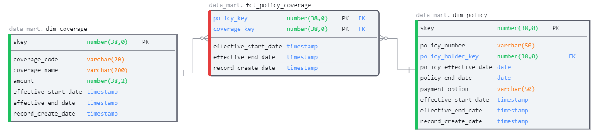
Types Of Fact Tables
Factless Fact:
Factless tables simply mean the key available in the fact that no remedies are available.

Slide 13
OLAP vs OLTP
 | OLTP | OLAP
Characteristics | Handles a large number of small transactions | Handles large volumes of data with complex queries
Query types | Simple standardized queries | Complex queries
Operations | Based on INSERT, UPDATE, DELETE commands | Based on SELECT commands to aggregate data for reporting
Response time | Milliseconds | Seconds, minutes, or hours depending on the amount of data to process
Design | Industry-specific, such as retail, manufacturing, or banking | Subject-specific, such as sales, inventory, or marketing
Source | Transactions | Aggregated data from transactions
Purpose | Control and run essential business operations in real time | Plan, solve problems, support decisions, discover hidden insights
Data updates | Short, fast updates initiated by user | Data periodically refreshed with scheduled, long-running batch jobs
Space requirements | Generally small if historical data is archived | Generally large due to aggregating large datasets
Backup and recovery | Regular backups required to ensure business continuity and meet legal and governance requirements | Lost data can be reloaded from OLTP database as needed in lieu of regular backups
Productivity | Increases productivity of end users | Increases productivity of business managers, data analysts, and executives
Data view | Lists day-to-day business transactions | Multi-dimensional view of enterprise data
User examples | Customer-facing personnel, clerks, online shoppers | Knowledge workers such as data analysts, business analysts, and executives
Database design | Normalized databases for efficiency | Denormalized databases for analysis

Slide 14
Data Modelling Software & Tools
Software:
Erwin Data Modeler (Desktop App)
SQLdBM (https://sqldbm.com)
DBDesigner (https://www.dbdesigner.net)
Edraw Max (https://www.edrawsoft.com)
Other Tools:
Draw IO
MS Excel
MS PowerPoint
MS Visio

Slide 15
Thank You

